Slide 1

Project 2: Theta Pirates
By: Kiel Wheat
Austin Avent
Gabriel Valenzuela

Slide 2
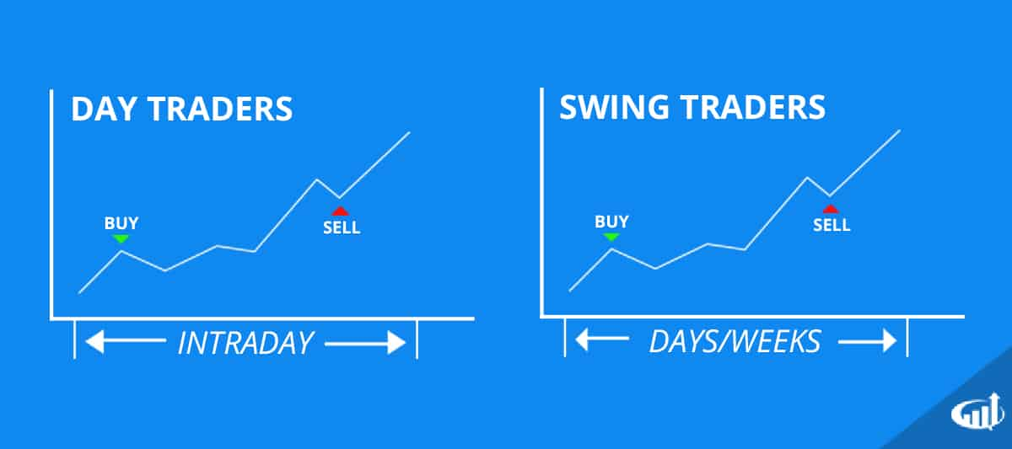
Motivation:
There are several approaches to trading profitability, all of which rely on some key element.
Just to name a few:
Day Trading relies heavily on timing to get on the right side of small changes within a day
Position trading, or the buy and hold strategy, relies on finding good value stocks with longterm good outlooks. It largely relies on time to return profit
Then you have Swing traders and option buyers, who are anticipating breakthroughs or plummets in a price. They are relying on large movement happening in a short time

Slide 3

But none of these strategies allow you to be wrong, and still make money...
But there is one strategy where you can be wrong within a certain margin about the direction of where a stock is going, but still make money. That is selling out of the money options.
*Now of course there's a big caveat to this, we’ll get to. Before we get to the risks and the hypothesis we’re testing, let's do a quick breakdown of what options are so everyone can follow along.

Slide 4
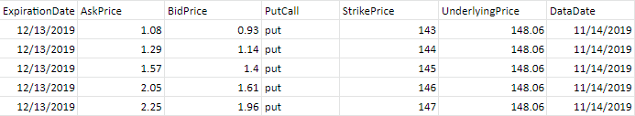

What are Options?
Options are contracts where the buyer has the privilege, but not obligation, to buy or sell 100 shares at a certain price (strike price) at a certain time.

Slide 5
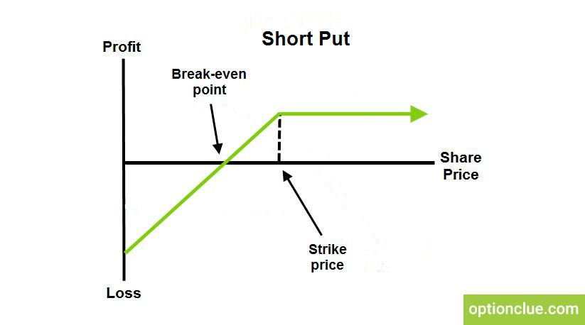
Hypothesis:
- Selling puts AMD, MSFT, AAPL, TSLA, that we find bullish and the market overall is bullish
-For a put seller, the outcomes are like this:
-Our working strategy is to sell out-of-the-money options we are afforded a certain amount of margin of error, one we’re actually able to choose. So let's figure out how accurate our predicted signals are, and make our margin of error larger than that.

Slide 6
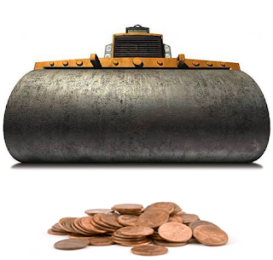
Pennies on a Steam Roller...
Since making money even when you’re wrong sounds too good to be true, well yes in accordance with the laws of risk and reward you’d be right to be skeptical. This kind of income generating trading is referred to as collecting pennies in front of a steam roller.
The downside - did you guys hear Tesla short sellers lost more money than the entire airline industry this year?

Slide 7
Why?
We wanted to test the hypothesis that a stock that has negative news, is below its standard price deviation and yet has experienced both high options and underlying stock volume may be a candidate for an upside move 7 days into the future.
IF the model’s are good, then an out of the money put selling strategy captures theta (time value) and can create a risk averse strategy where the margin of error is dependent on the strike price minus underlying price

Slide 8
Data Preparation:
However let's take a closer look at where we are selling puts:
Collect Alpaca data for 4 stocks (TSLA, AMD, AAPL, MSFT) and related news for sentiment analysis (6 month test/train based on available daily options closing data)
Engineer relevant features: Bollinger band, relative volume, options volume and sentiment analysis
Run LSTM RNN and Random Forest models with a 7 day forward projection target and 70% test/train split
Design an options “wrapper” that takes entry signals and tracks them over multiple strike ‘zones’
ATM, “medium” and “far” OTM zones
Look at 2 different holding time frames: weekly and bi-weekly

Slide 9
Feature Engineering:
Using the NYT API, search for headlines containing Tesla, Apple, Microsoft, AMD over 6 month time period and create sentiment scores.
Create RF signals for price < Bollinger lower band (1 Std)
Create RF signals for volume > relative vol (rvol) (1 Std)
Create RF signals for options volume > options rvol (1Std)
LSTM use the same data (no signals), but normalized
*Drawback: No headlines containing AMD for our 6 month test/train period.

Slide 10
Techniques used to evaluate the model performance:
The “norms”: accuracy, false positives. Stuff that almost gets to the heart of real risk management….
The part that matters the most is the path that your equity curve took to its “final destination” if you’re going to manage OPM

Slide 11

LTSM Results:

Slide 12
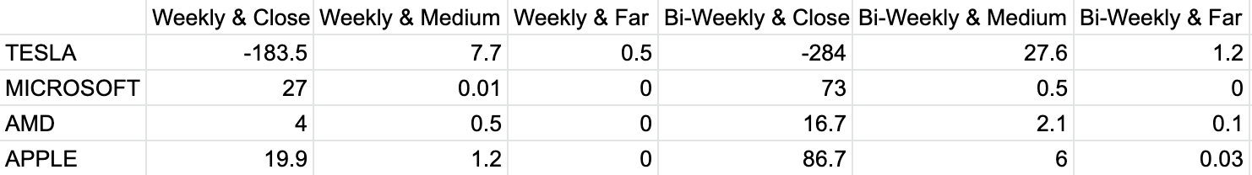
Random Forest Results:

Slide 13
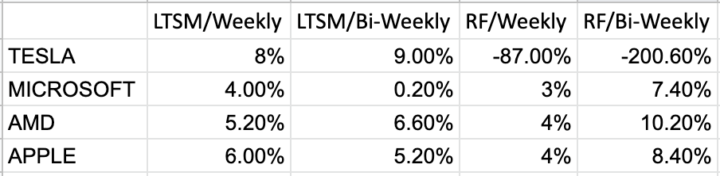
Return on Investment:

Slide 14
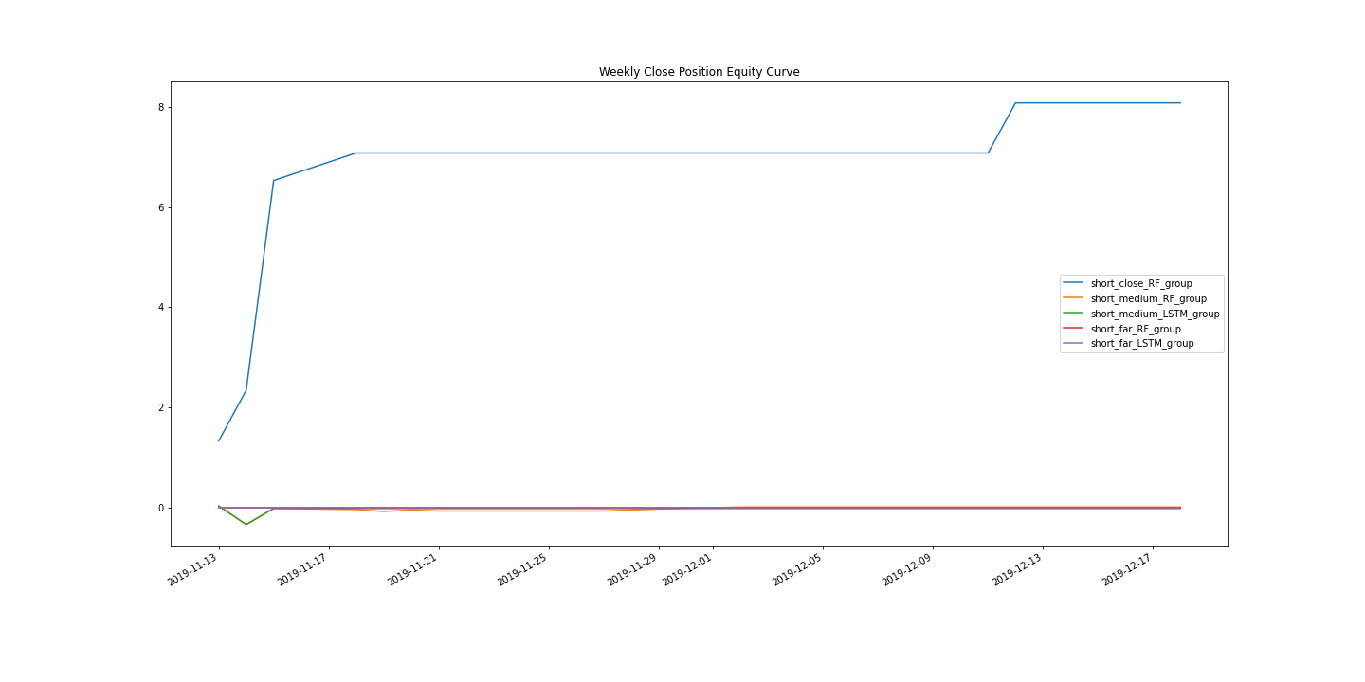
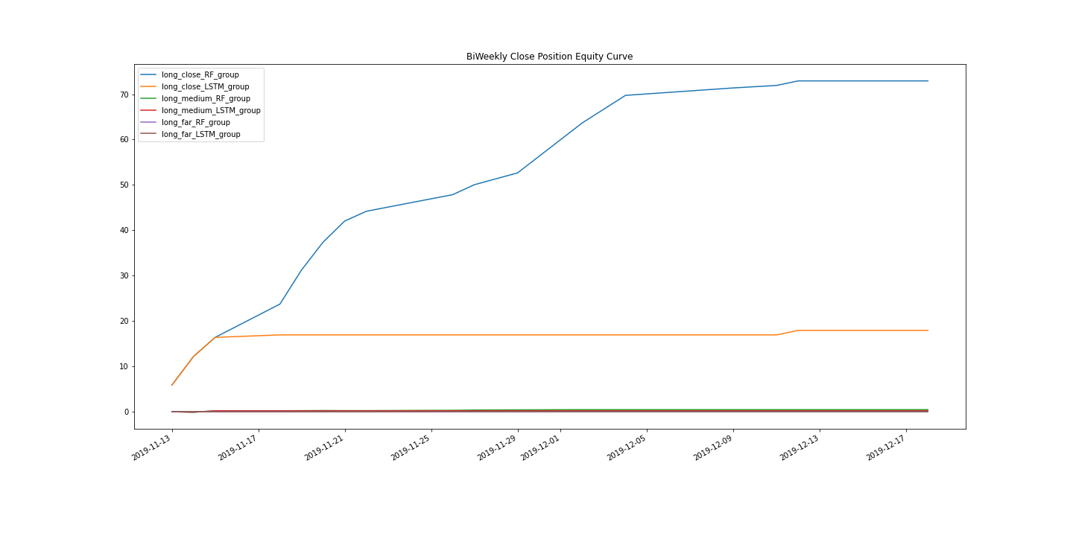

Microsoft:

Slide 15
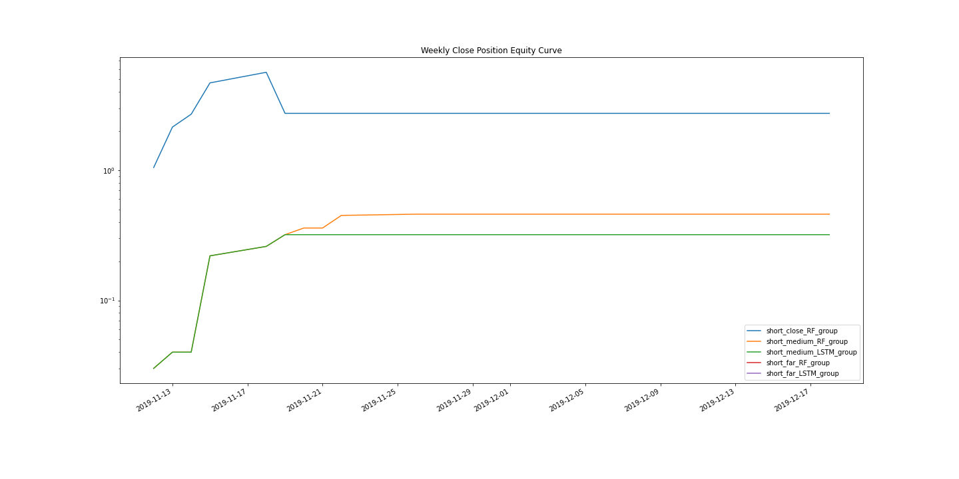
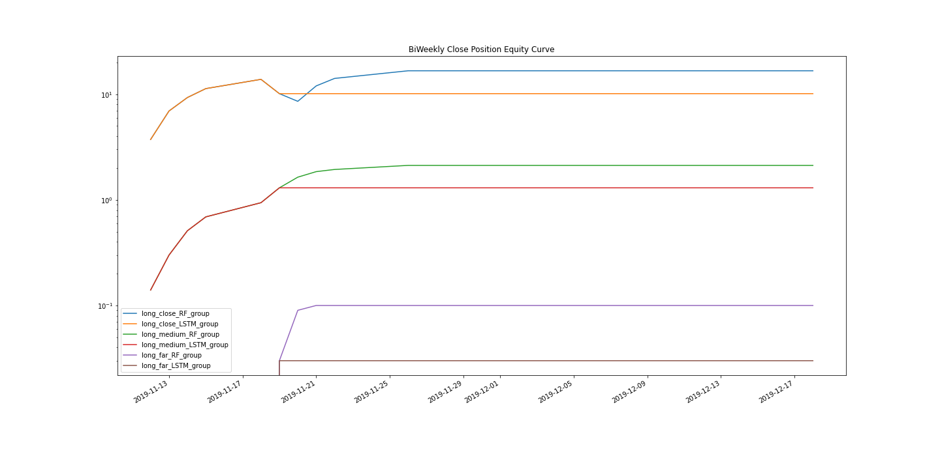
AMD:

Slide 16
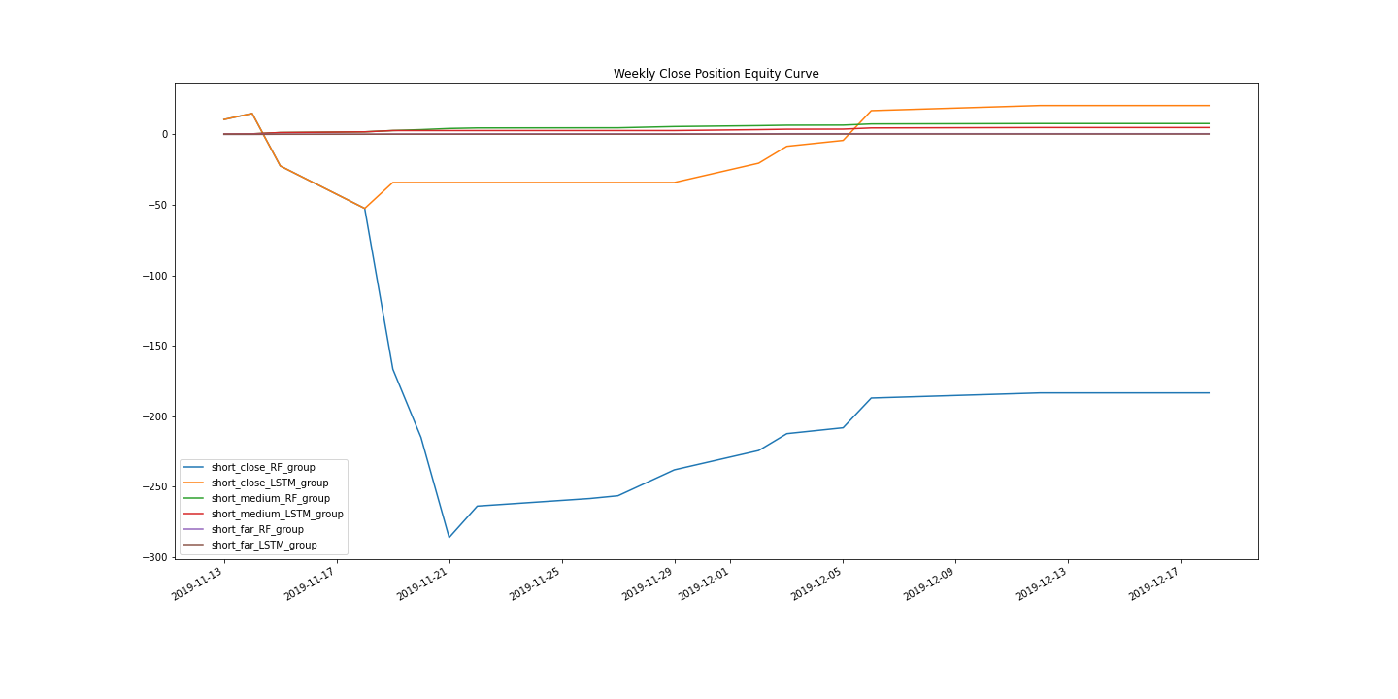
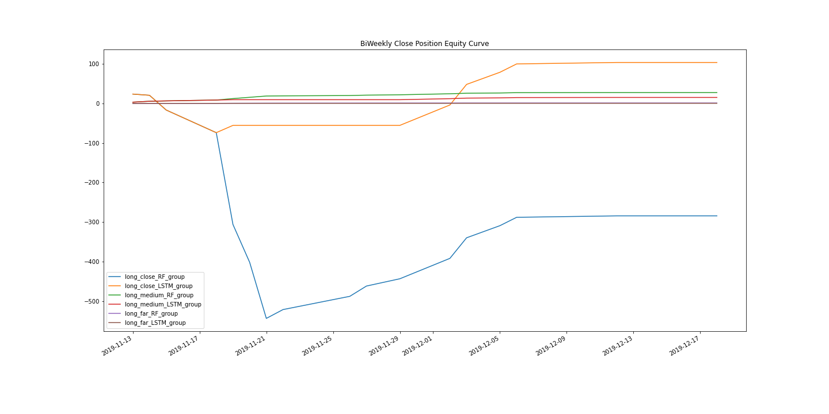
Tesla:

Slide 17
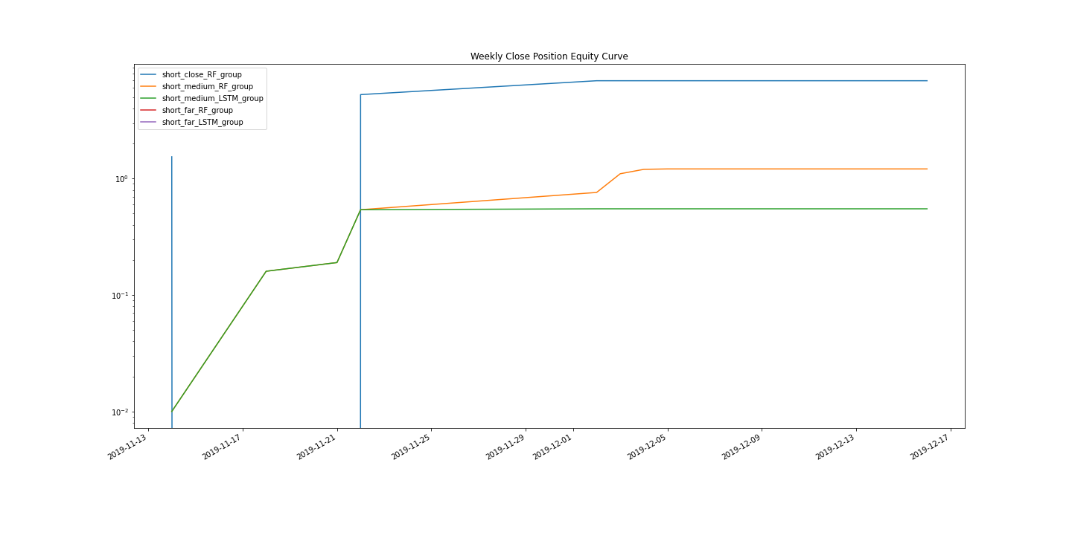
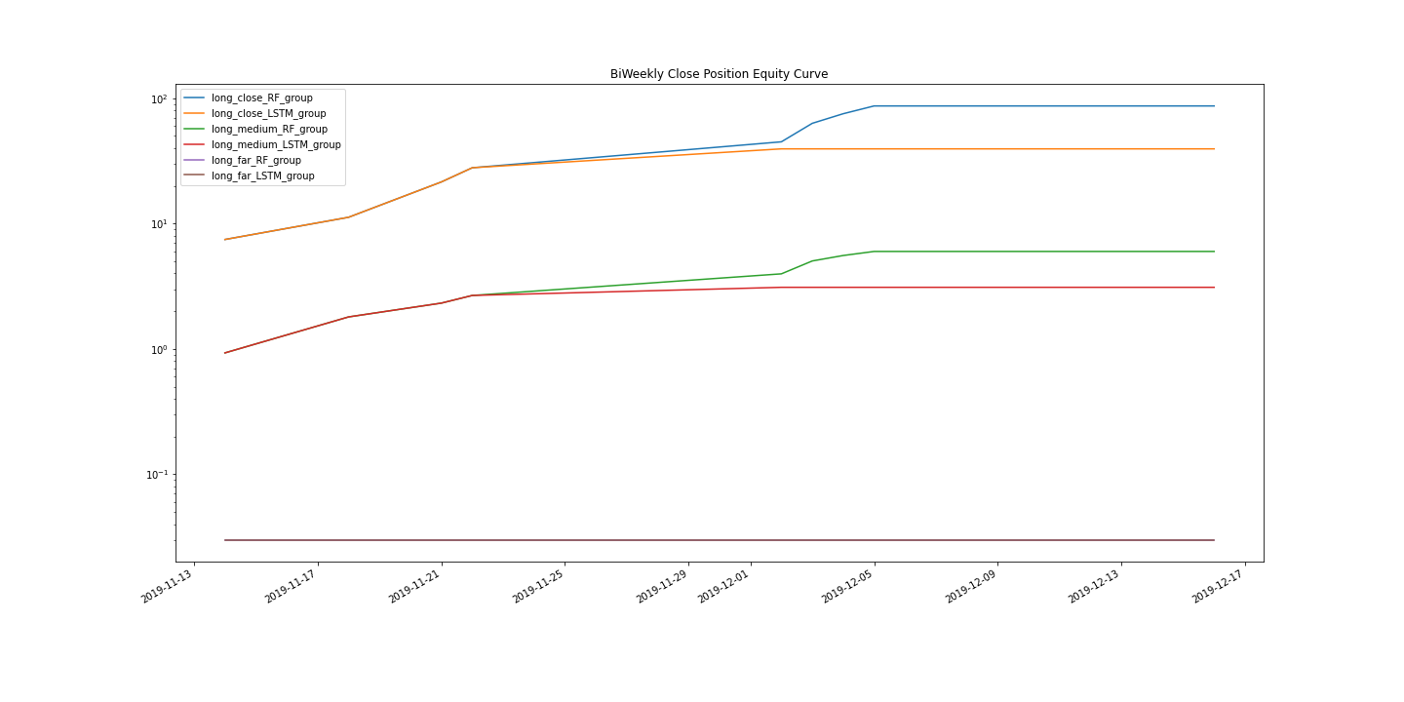
Apple:

Slide 18
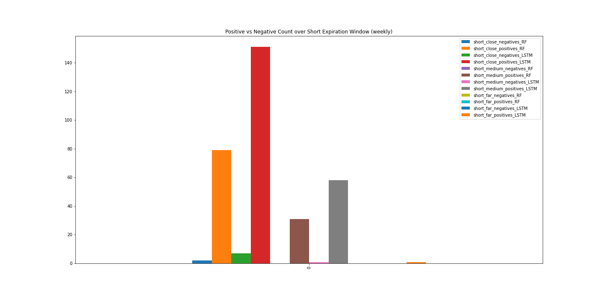
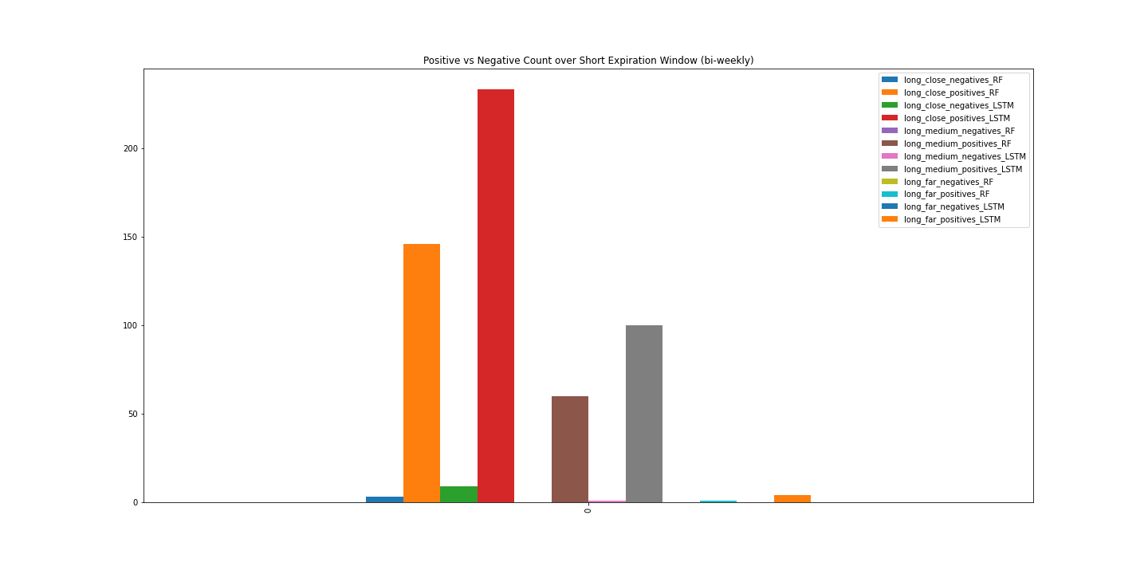
Conclusions and Portfolio Implications:
It’s all about perspective… for example AAPL
Equity curve path
Max Drawdown of either model
Short window- 2.57
Long window- 0
Total Capital needed to implement strategy
Difference between options returns and underlying stock algo return

Slide 19
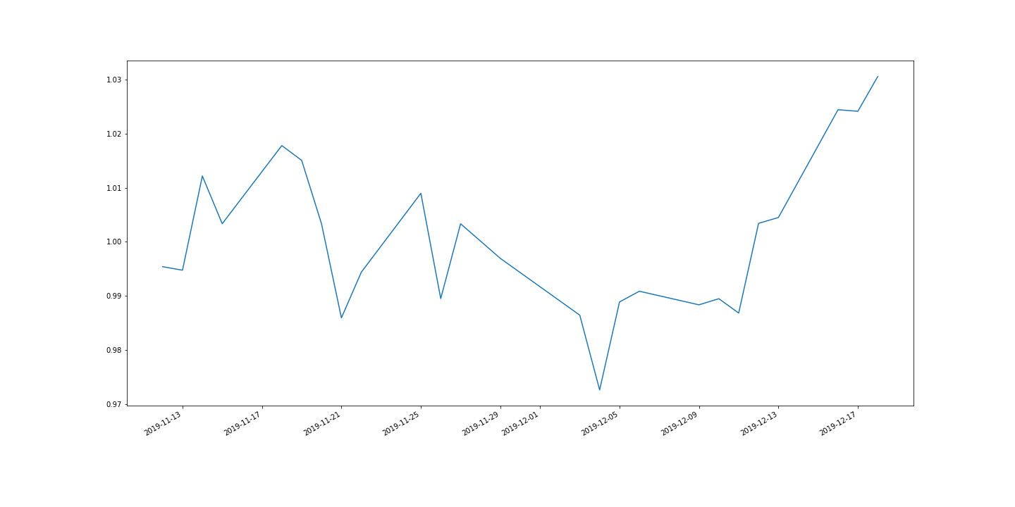
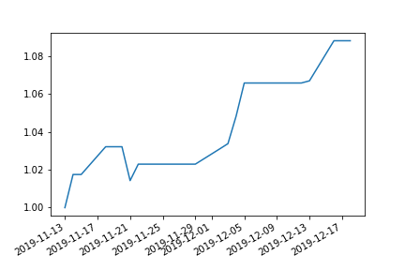
Cont’d: Apple Underlying
LSTM RNN RANDOM FOREST

Slide 20
Drawbacks:
Signals: NYT did not contain enough headlines containing AMD.
Data: We had to build our own options wrapper around the models. For every trading day there are dozens of strikes where entries and expirations have to be tracked. That was a ton of work dealing with multiple positions. Some of our stocks didn’t have signals because options expirations, signals and test time frames don’t match up perfectly.
Depth of analysis: We just scraped the surface of designing options portfolios.

Slide 21
If we had more time...
Create a bigger portfolio of stocks and consider designing options portfolios
Optimize forward looking window of the LSTM and RF models
Filter for an array of more refined features through a dashboard
Long term trend, short term momentum and other market structure filters
Create variables/strategies for risk management, starting equity, max drawdown
Create a better equity curve that can track individual position paths
Find a better API for news sentiment (likely paid subscription)
Use option Greeks for more analysis (more paid subscriptions….)
Create more comparison tools- did this do better than just buy and hold the underlying…?

Slide 22
Questions???
Thank you.

